Slide 1
Updating of the Manual on Statistics on International Trade in Services (MSITS)
Prelude: Towards MSITS 2026
by
Vysaul Nyirongo (email: nyirongov@un.org)

Slide 2
The MSITS revision team
Chief editors: Barbara D’Andrea (WTO) and Antonella Liberatore (OECD)
Chapter leads: Alexis Grimm (USA), Andrea Carboni (ITA), Dyana Wyman (CAN), Cristina Neves (PRT), George Papadopoulos (Eurostat), Ilda Duarte (DEU), Annette Meinusch (DEU), Habibur Khan (UNSD)
Contributors: Markie Muryawan (UNSD), Ying Yan (WTO), Iliyana Savova (Eurostat), Melike Yalin Altun (TUR), Esmond Mclean (JAM), Rigoberto Torres Mora (CRI), Jiayue Zeng (UNSD), Daniel Ker (UN Trade and Development), Patrick Quill (IMF), Vysaul Nyirongo (UNSD), Nancy Snyder (UNSD), Leandry Moreno (UN Tourism), Jürgen Weiss (AUT)

Slide 3
Do we need a new MSITS?
With BPM7, SNA 2025, the Eurostat guidance on FATS and trade in services by mode of supply; ISIC Rev.5 and CPC Rev.3
How can we make sure MSITS is still relevant?
MULTIDIMENSIONALITY
INTEGRATION
GRANULARITY
Notes:
Integration (integrated framework)
Multidimensionality
Detail/granularity

Slide 4
Outline
Guiding principles for the revision
Broad structure of MSITS 2026
Timeline & next steps

Slide 5
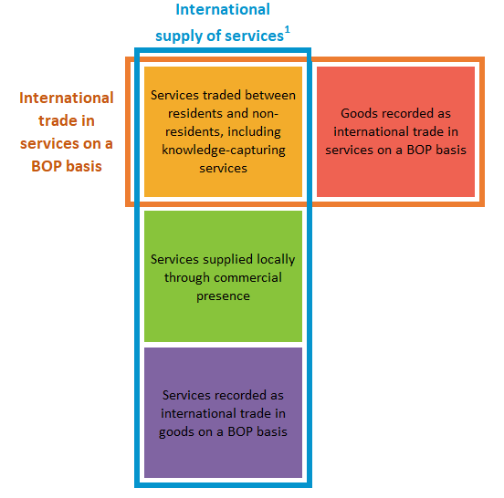
MSITS revision – guiding principles
Integrated approach & clear terminology
Different measures stem from different statistical frameworks
These measures can have different breakdowns across several dimensions

Slide 6
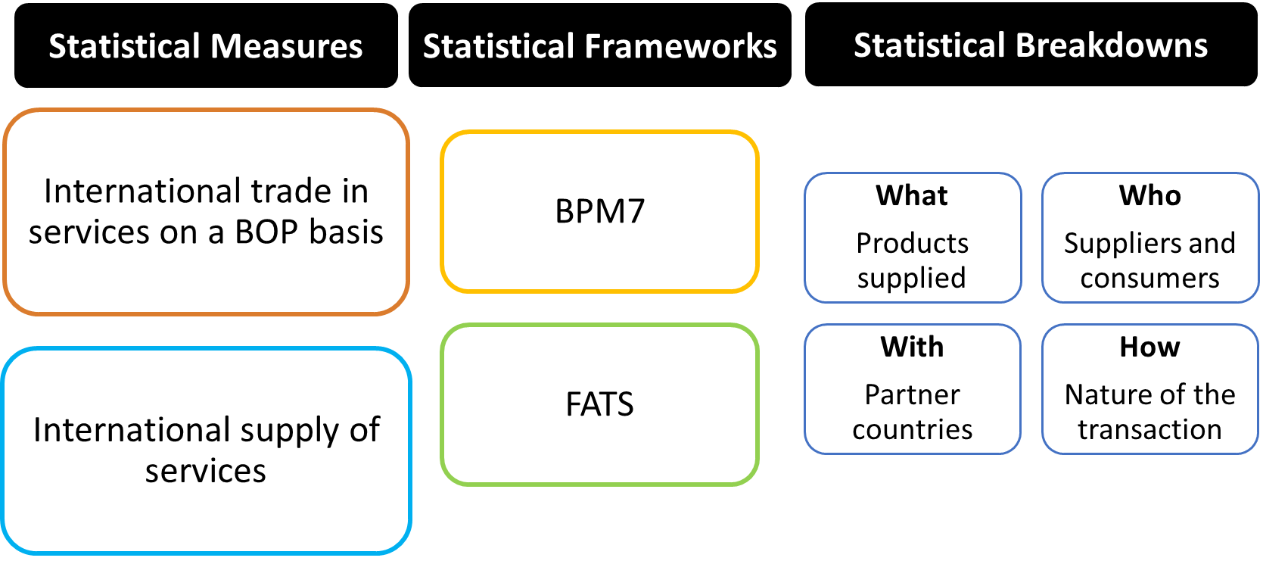
MSITS revision – guiding principles
Integrated approach & clear terminology
Notes:
Provide a holistic view of the international supply of services, encompassing different statistical frameworks (BPM and FATS), different measures and different breakdowns

Slide 7
MSITS revision – guiding principles
Focus on services
Streamline parts not strictly related to the international supply of services
Consistency with BPM7 and SNA 2025
With additional value for users and compilers
Concise manual: minimize repetitions, concepts only (to the extent possible)
But ‘look at concepts with a compiler’s eye’
Accessible manual: clear and simple English
Modern manual: increased use of visuals where possible
Alignment with IMTS where needed
Notes:
Look at concepts with a compiler’s eye (Diana): are they applicable in all circumstances (e.g. digital presence vs residency)
Note down compilation issues as we work on the concepts (Andrea) to facilitate CG

Slide 8
Outline of the new MSITS (1/2)
Note: chapter headings are tentative and could be revised
Introduction (update)
A conceptual framework for measuring international trade in services (substantial revamping)
International trade in services on a balance of payments basis (update)
FATS and the international supply of services through commercial presence (update)
Notes:
Provides a more complete definition of products and whether they are recorded as goods or services
Particularly for knowledge-capturing products
Presents a new conceptual framework that
Establishes the scope of MSITS and relevant statistical domains
Presents the frameworks/measures/breakdowns for international supply of services statistics
Lays the groundwork for the structure of the manual
Reduces or relocates much of the background information
Discussion of the history of GATS will be condensed
Descriptions of statistical systems and classifications related to trade in services will be moved to an appendix
Same scope as the BPM7 chapter on services
Structure streamlined (and aligned between chapters 3 and 4)
Will be based on the new EBOPS (presentation later)
FATS and the international supply of services through commercial presence (update)
Basic FATS/AMNE concepts kept (in line with SNA 2025)
Shortening of current text to focus on service supply via commercial presence
Recommendations on ICFA dropped

Slide 9
Outline of the new MSITS (2/2)
Note: Chapter headings are tentative and could be revised
International trade in services: statistical breakdowns across different dimensions (mostly new chapter)
Will cover (updated) text on trade in services by modes of supply, digital trade in services, STEC…
Quantitative indicators on the international supply of services (mostly new chapter)
Data quality and dissemination (new chapter)
Annexes (update)
Notes:
While chapters 3 and 4 deal with the two core statistical frameworks, this chapter will develop the measures and breakdowns covered by the conceptual framework:
What is traded (with additional granularity)
With partner countries
How trade takes place (modes of supply, digital trade, sustainably...) Who trades (STEC, gender dimension…)

Slide 10
Timeline & next steps
EBOPS 2026 just finalized
Task Team reviewing chapters (last two weeks in April)
Expect complete drafts for the Marrakesh meeting of the Task Team (6-9 May)
First complete draft by mid 2026, final version by end 2026

Slide 11
Recap:
Clear focus/articulation : International supply of services, Trade in services BOP, FATS ; and recommended classifications (CPC, EBOPS, and ISIC respectively)
Conceptual framework of the digital trade measurement;
Who dimension in new Chapter 5, focusing on STEC and gender.
Quantitative indicators in Chapter 6, including volume indices
Data quality and dissemination (new chapter): aligning with UN-QAF, HIBTS, IMTS
Annexes, including EBOPS 2026, and recognizing other classifications relevant for trade in services statistics.
EBOPS components by product (and by SNA end-use where applicable); more detail

